Slide 1
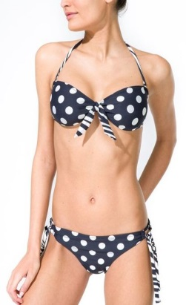
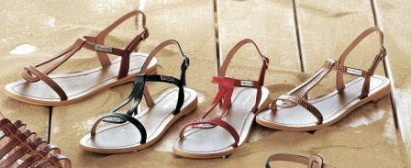
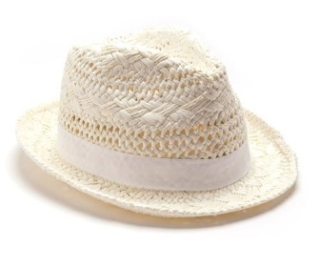
Get Beach Ready with La Redoute
With summer just around the corner, it’s the perfect time to feast your eyes on La Redoute’s collection of stylish swimwear and accessories for the holiday season.
Be inspired with body-shaping tankinis, sophisticated cover-up maxi dresses, swimsuits and à la mode bikinis.
Not to forget the all important sandals and hats for the ultimate beach-ready attire.
Look no further for sizzling French-inspired swimwear and must have fashion staples for every holiday maker this coming summer season. Bon été!
La Redoute polka dot bikini, £15
La Redoute embroidered blouse, £29
La Redoute bodyshaping swimsuit, £39
La Redoute Les Tropeziennes leather sandals, £59
La Redoute straw fedora hat, £21
Press Office 08444 842 5270
@laredouteUKPR
laredoute@onlybeattie.com
La Redoute PR Shots
La Redoute cover up maxi dress, £39
La Redoute bodyshaping tankini, £35

