Slide 1
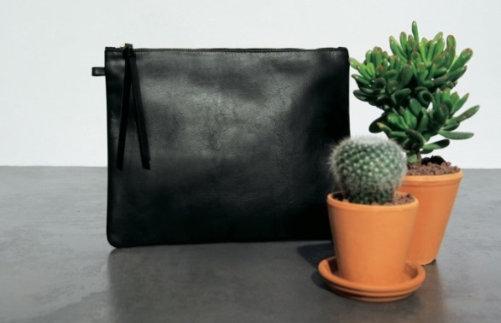
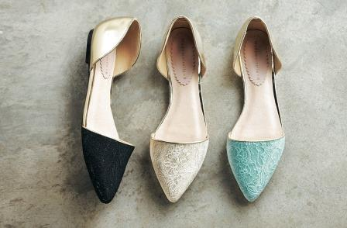
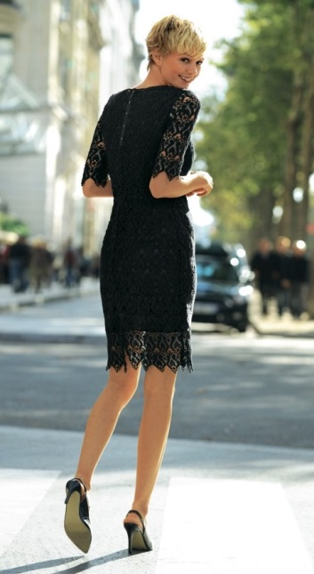
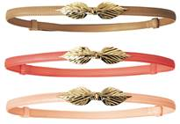
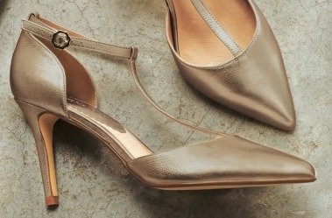
Effortless occasion wear from La Redoute
The first signs of summer are here and at La Redoute we’re dreaming of days at the races, elegant weddings and chic garden parties.
Say bonjour to long summer nights and au revoir to the couch! La Redoute is bringing some ooh la la to occasion wear this season.
It’s time to embrace Parisian style with delicate dresses, oh-so-stylish sandals and pretty pumps. Thanks to our French fashion know-how, you can get that je ne sais quoi with creamy pastels, a flash of gold or some dreamy lace.
Clutch bag £49
Mademoiselle R dress £59
Mademoiselle R ballet pumps £39
Belt £19
Press Office 08444 842 5270
@laredouteUKPR
laredoute@onlybeattie.com
La Redoute PR Shots
Mademoiselle R dress £59
Clutch bag £19
Laura Clement Guipure lace dress £89
Gold t-bar sandals £69

