Slide 1
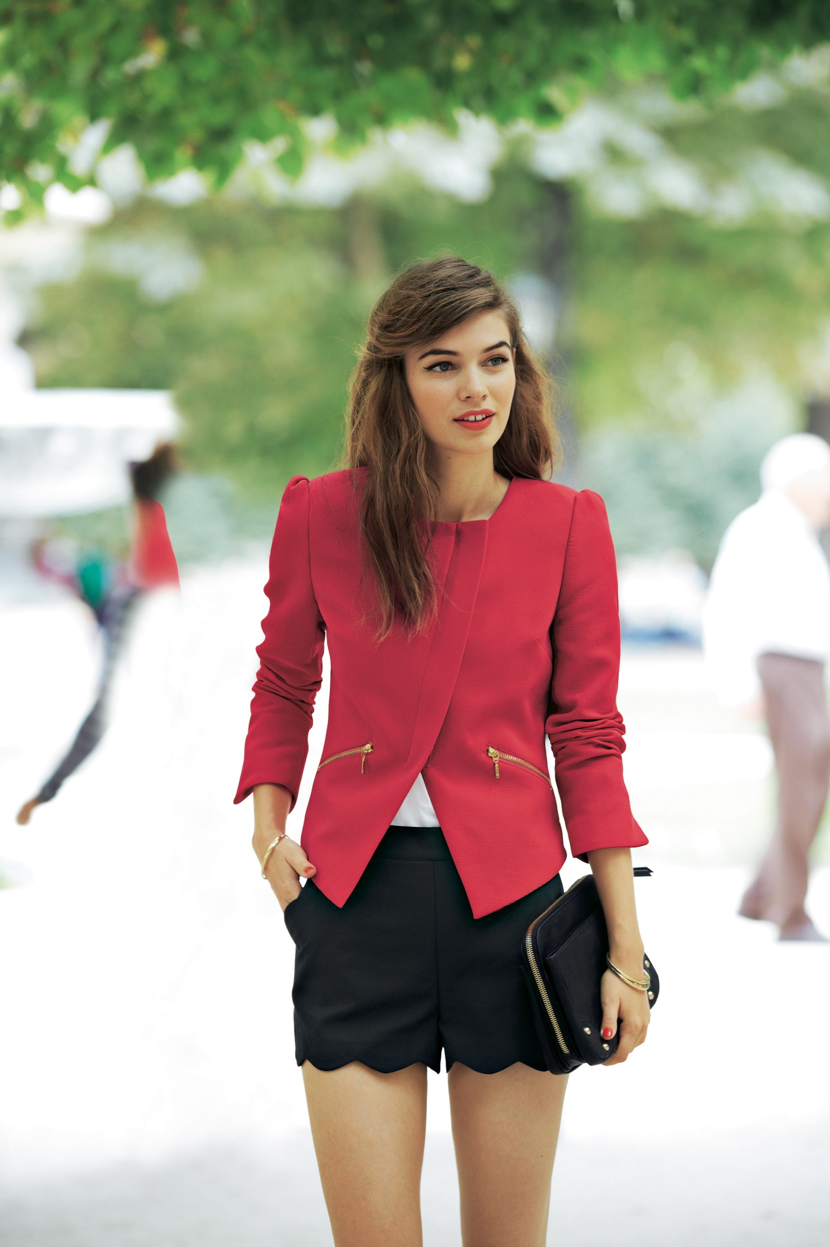
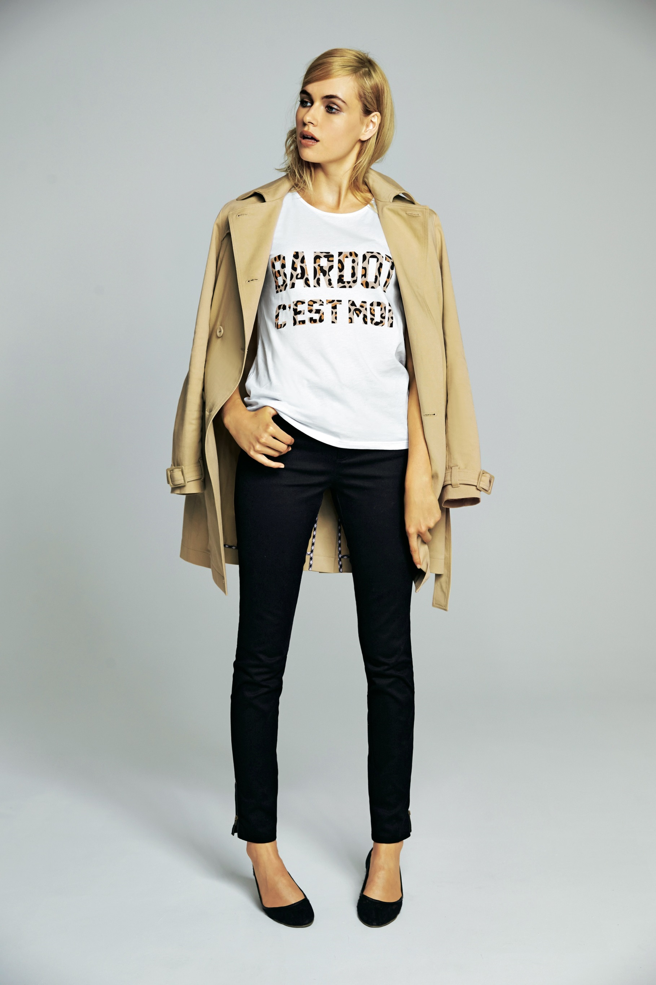
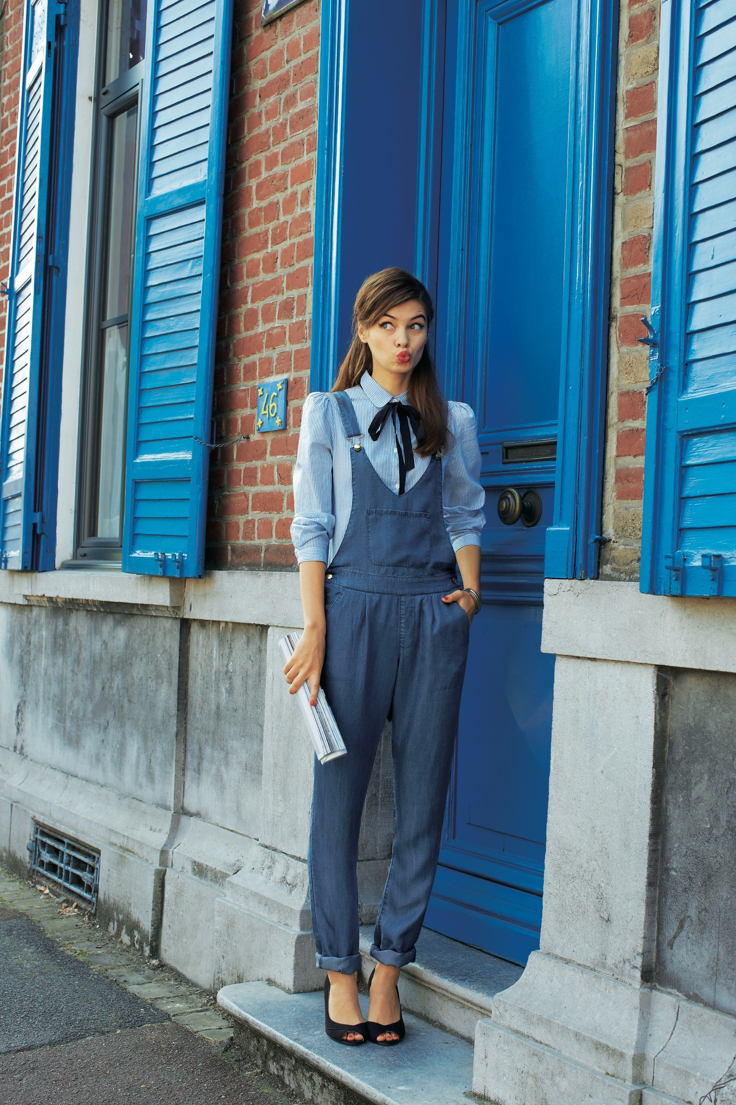
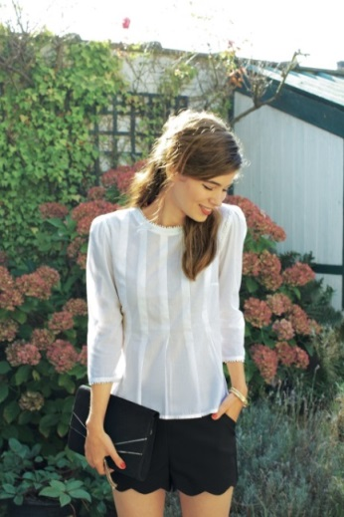
Fabulously French essentials from La Redoute
The secrets behind French style are out and fashion forward women can now embrace a touch of Parisian elegance thanks to La Redoute.
From chapeau to chausseures, effortless chic is the name of the game. Keep it simple with a trench or a breton, adding stylish touches with a peplum waist or a pussy bow.
And where better to look for inspiration than La Redoute’s classic collections, such as the range from French style icon, Brigitte Bardot.
Thanks to La Redoute, a touch of je ne sais quoi can be added to any woman’s wardrobe.
Laura Clement breton-style sweater
£59
Mademoiselle R shorts
£29
Brigitte Bardot sleeveless dress
£99
Brigitte Bardot trench coat
£99
Press Office 0844 842 5270
@laredouteUKPR
laredoute@onlybeattie.com
La Redoute PR Shots
Mademoiselle R pussy bow blouse
£35
Mademoiselle R peplum blouse
£35

